Slide 1
Pointers,
Polymorphism, and
Memory Allocation
C++ Interlude 2
Data Structures and Problem Solving with C++: Walls and Mirrors, Carrano and Henry, © 2013

Slide 2
Contents
Memory Allocation for Variables and Early Binding of Methods
A Problem to Solve
Pointers and the Program’s Free Store
Virtual Methods and Polymorphism
Dynamic Allocation of Arrays
Data Structures and Problem Solving with C++: Walls and Mirrors, Carrano and Henry, © 2013

Slide 3
Memory Allocation for Variables and Early Binding of Methods
A function’s locally declared variables placed into run-time stack
Storage for newly created object placed into activation record
  Instantiated objects placed into run-time stack
Data Structures and Problem Solving with C++: Walls and Mirrors, Carrano and Henry, © 2013

Slide 4
Memory Allocation for Variables and Early Binding of Methods
Early binding
  Memory location set during compilation
  Cannot be changed during execution
Sometimes early binding and automatic memory management insufficient
  In context of polymorphism
  Access of an object outside of the function or method that creates it.
Data Structures and Problem Solving with C++: Walls and Mirrors, Carrano and Henry, © 2013

Slide 5
Memory Allocation for Variables and Early Binding of Methods
From previous Interlude …
Creating a video game with a group of classes to represent three types of boxes
  Plain box, Toy box, Magic box
Function with two arguments:
  Object of any of the three types of boxes
  An item of type string
  Should place item in box with setItem method.
Data Structures and Problem Solving with C++: Walls and Mirrors, Carrano and Henry, © 2013

Slide 6
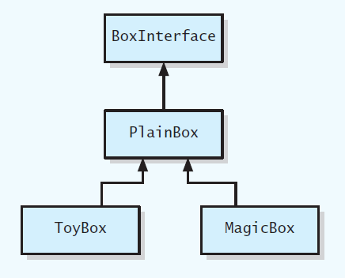
Memory Allocation for Variables and Early Binding of Methods
FIGURE C2-1 UML class diagram for a family of classes
Data Structures and Problem Solving with C++: Walls and Mirrors, Carrano and Henry, © 2013

Slide 7
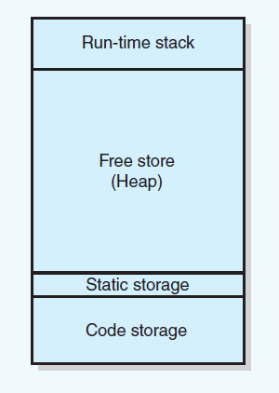
Pointers and Program’s Free Store
FIGURE C2-2 Sample program memory layout
Data Structures and Problem Solving with C++: Walls and Mirrors, Carrano and Henry, © 2013

Slide 8
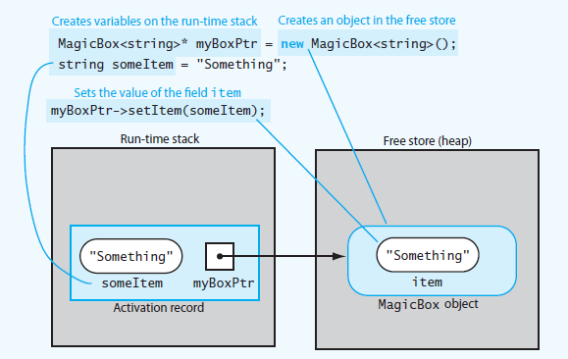
Pointers and Program’s Free Store
FIGURE C2-3 Run-time stack and free store after myboxPtr points to a MagicBox object and its data member item is set
Data Structures and Problem Solving with C++: Walls and Mirrors, Carrano and Henry, © 2013

Slide 9
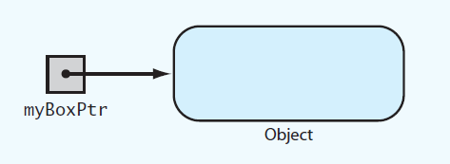
Pointers and Program’s Free Store
FIGURE C2-4 myBoxPtr and the object
to which it points
Data Structures and Problem Solving with C++: Walls and Mirrors, Carrano and Henry, © 2013

Slide 10
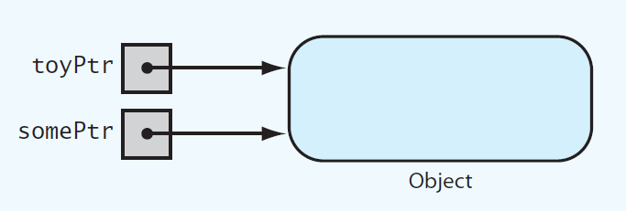
Pointers and Program’s Free Store
FIGURE C2-5 Two pointer variables that
point to the same object
Data Structures and Problem Solving with C++: Walls and Mirrors, Carrano and Henry, © 2013

Slide 11
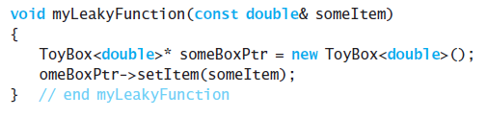
Pointers and Program’s Free Store
Other issues:
Deallocating Memory
Avoiding Memory Leaks
LISTING C2-1 Poorly written function that allocates memory in the free store
Data Structures and Problem Solving with C++: Walls and Mirrors, Carrano and Henry, © 2013

Slide 12
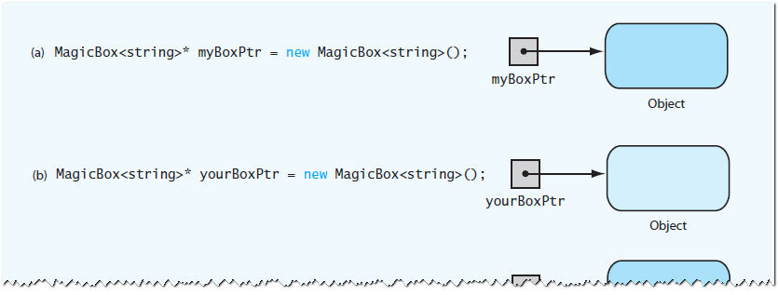
Pointers and Program’s Free Store
FIGURE C2-6 (a) Creating the first object;
(b) creating the second object;
Data Structures and Problem Solving with C++: Walls and Mirrors, Carrano and Henry, © 2013

Slide 13
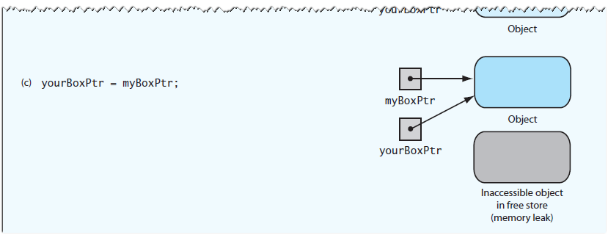
Pointers and Program’s Free Store
FIGURE C2-6 (c) assignment causes an inaccessible object
Data Structures and Problem Solving with C++: Walls and Mirrors, Carrano and Henry, © 2013

Slide 14
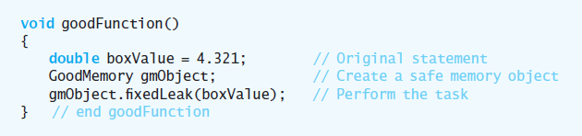
Pointers and Program’s Free Store
View Listing C2-2 Header file for the class GoodMemory
Consider Listing C2-3 Implementation file for the class GoodMemory
Contrast myLeakyFunction
.htm code listing files must be in the same folder as the .ppt files for these links to work
Data Structures and Problem Solving with C++: Walls and Mirrors, Carrano and Henry, © 2013

Slide 15
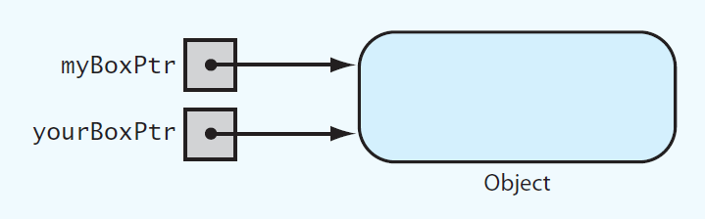
Avoiding Dangling Pointers
FIGURE C2-7 Two pointers referencing
(pointing to) the same object
Data Structures and Problem Solving with C++: Walls and Mirrors, Carrano and Henry, © 2013

Slide 16
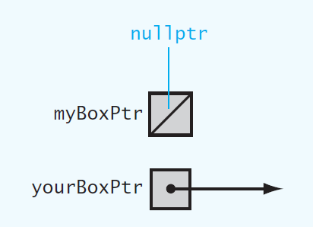
Avoiding Dangling Pointers
FIGURE C2-8 Example of a dangling pointer
Data Structures and Problem Solving with C++: Walls and Mirrors, Carrano and Henry, © 2013

Slide 17
Avoiding Dangling Pointers
How to avoid dangling pointers
Set pointer variables to nullptr either initially or when you no longer need them
Test whether a pointer variable contains nullptr before using
Don’t delete object in free store until certain no other alias needs it
Set all aliases that reference a deleted object to nullptr when object is deleted
Data Structures and Problem Solving with C++: Walls and Mirrors, Carrano and Henry, © 2013

Slide 18
Virtual Methods and Polymorphism
Consider Listing C2-4 Revised header file for the class PlainBox
Key points about virtual methods
A derived class can override
Must implement a class’s virtual methods
Derived class does not need to override existing implementation of inherited virtual method.
Data Structures and Problem Solving with C++: Walls and Mirrors, Carrano and Henry, © 2013

Slide 19
Virtual Methods and Polymorphism
Key points about virtual methods
Any of a class’s methods may be virtual.
Constructors cannot be virtual
Destructors can and should be virtual. If you do not want derived class to override a particular method, it should not be virtual
Virtual method’s return type cannot be overridden
Data Structures and Problem Solving with C++: Walls and Mirrors, Carrano and Henry, © 2013

Slide 20
Dynamic Allocation of Arrays
Ordinary C++ array is statically allocated
Use new operator to allocate an array dynamically
delete returns dynamically allocated array to system for reuse
You can increase size of dynamically allocated array
Data Structures and Problem Solving with C++: Walls and Mirrors, Carrano and Henry, © 2013

Slide 21
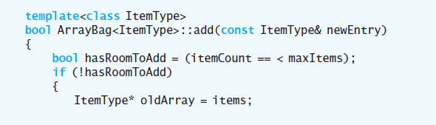
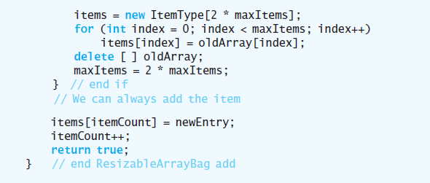
A Resizable Array-Based Bag
Data Structures and Problem Solving with C++: Walls and Mirrors, Carrano and Henry, © 2013

Slide 22
End
Chapter C++ Interlude 2
Data Structures and Problem Solving with C++: Walls and Mirrors, Carrano and Henry, © 2013

